Slide 1
ENME 816 Final Presentation
Alex Dorsey
Mechanical Engineering Department
University of Maryland Baltimore County
December, 2025

Slide 2
Project Objective
Build an Interactive 3D quad-copter Simulator:
  Non Linear Rigid Body Dynamics
  Demonstrate Real Time Roll and Pitch Angle Estimation from Simulated Noisy IMU Data
  Adaptive Or Fixed Gain Inner-loop control
  Test bed for visualizing control systems effects on dynamic behavior
  FFT of estimated attitude to adjust low pass filter cut-off frequency

Slide 3
Project Motivation
Aligns with the Estimation and Control Learning Laboratory’s work at UMBC
Visualize quad copter and the effects the control system and various parameters have on the behavior
Make a ‘video game’ like application in Matlab

Slide 4
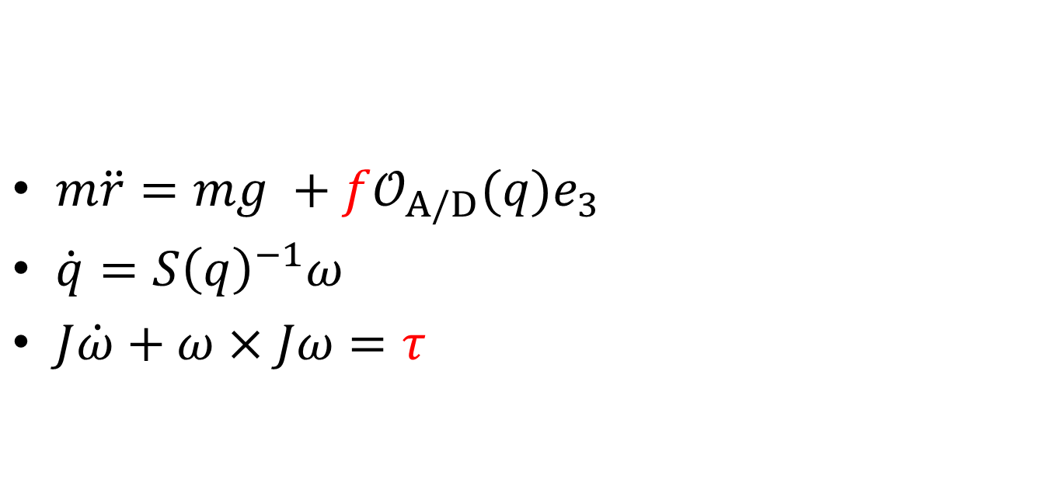
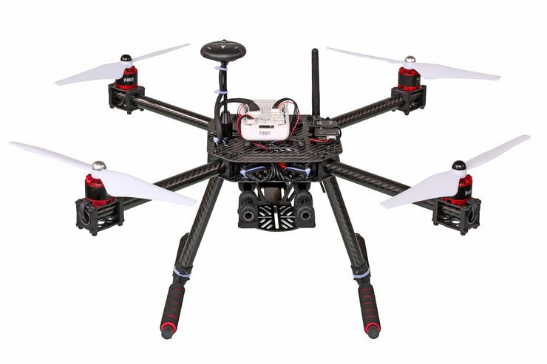
Data Source: Quadcopter Dynamics

Slide 5
Data Source
State Vector (12x1)
  Attitudes, body angular rates, position, and velocities (east, north, up).
  Determined Via Propagation of ODE function
Inputs and Disturbances
  Keyboard User Commands
  Process and measurement noise simulating the gyroscope and accelerator:
    Accelerator Data = Noise*Acceleration True + Bias
    Gyro Data = Noise*Body Rates True + Bias
    Noise is a user definable parameter in terms of frequency and magnitude.

Slide 6
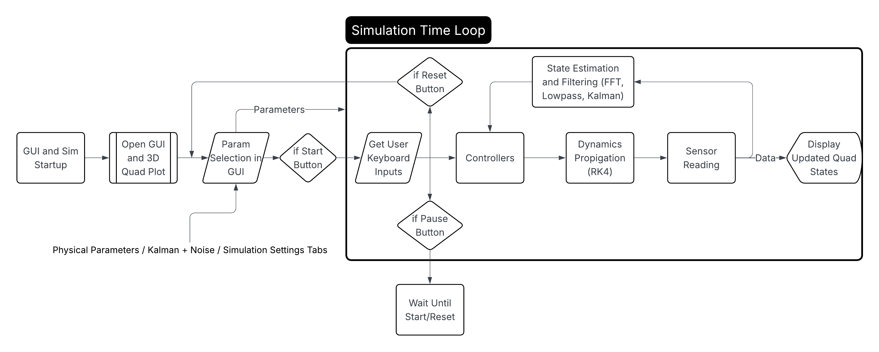
Algorithm: Flow Chart
* The parameters are checked for updates each step and startup

Slide 7
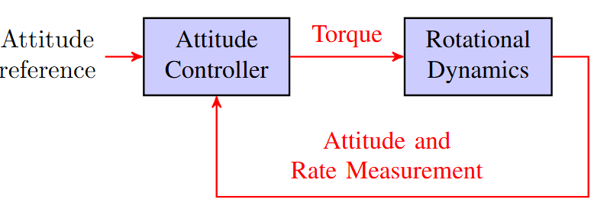
Algorithm: Multirotor Control Flow
Two Control Modes: Velocity Control and Attitude Control
Velocity Control: User Commands velocity forward, velocity sideways, and altitude
Angle Control: User commands roll, pitch, yaw, and altitude
Way point function replaces User Keyboard Inputs and outputs Velocity Ref
Internal Model Principle used to make controllers
force
User Inputs / Position Way points
Velocity Controller
Attitude Controller
Dynamics
Velocity
ref
attitude
ref
torque
states
altitude ref
Altitude Controller
force
force
User Keyboard Inputs
Attitude Controller
Dynamics
attitude
ref
torque
states

Slide 8
Algorithm: Multirotor Control Flow
Velocity Controller:
  PI controller (states are 3x1 vectors, gains are 3x3 diagonal matrices):
    Force Vector = P [Velocity Error] + I [Velocity Error Integral]
    Force = norm(Force Vector)
    Force Vector is used to calculated attitude commands because the motors’ shafts must always be co-linear with the Force Vector.
Altitude Controller
  Force = K [Velocity Up Error] + mg
    Attitude comes from user command -> no need for a force Vector.
Way Points:
  Cruising Velocity = P * Position Error
  If norm(Position Error) < user defined distance
    Velocity Ref = Cruising Velocity * Position Error/norm(Position Error)
  Else
    Velocity Ref = Cruising Velocity

Slide 9
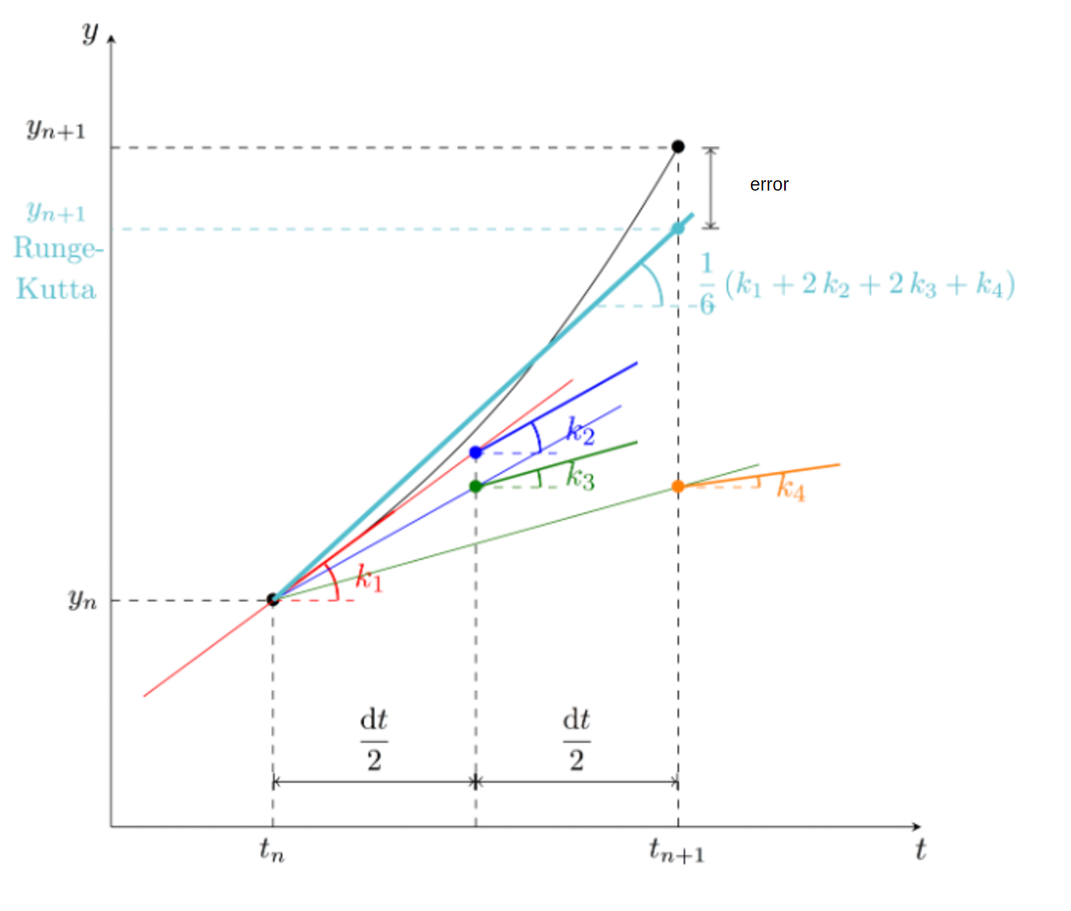
Course Related Concepts
ODE
  Non-Linear ODE
  ODE is propagated via Runge Kutta 4. A fourth order numerical integration technique.
Signal Processing:
  Kalman Filtering → estimated attitude from Noisy Data
  Lowpass Filtering → Filter Noisy Kalman Estimate
  FFT → Observe Frequency of Filtered Noisy Data to update Lowpass Filter
  Many Feedback loops from states and estimated states to update next control signal (Signal Processing at its core)
Rigid Body Visualization and GUI
  3D quadcopter model with rotation and translation for body and propellers
  Dynamic Camera Following with smoothed motion (first order filter)
  Projected Shadow on the ground plane
  Additional Plots:
    attitude history showing true vs estimated
    Top Down Position History
    FFT of estimated Angle

Slide 10
Varying Parameters
Demonstration

Slide 11
Future Work:
Extend State Estimation to Include the full state (currently only attitude)
Introduce wind disturbances
Higher Fidelity Quad Copter
Implement more adapter controllers
Improve Visualization
Speed up performance (needs a good CPU to run fast)

